Slide 1
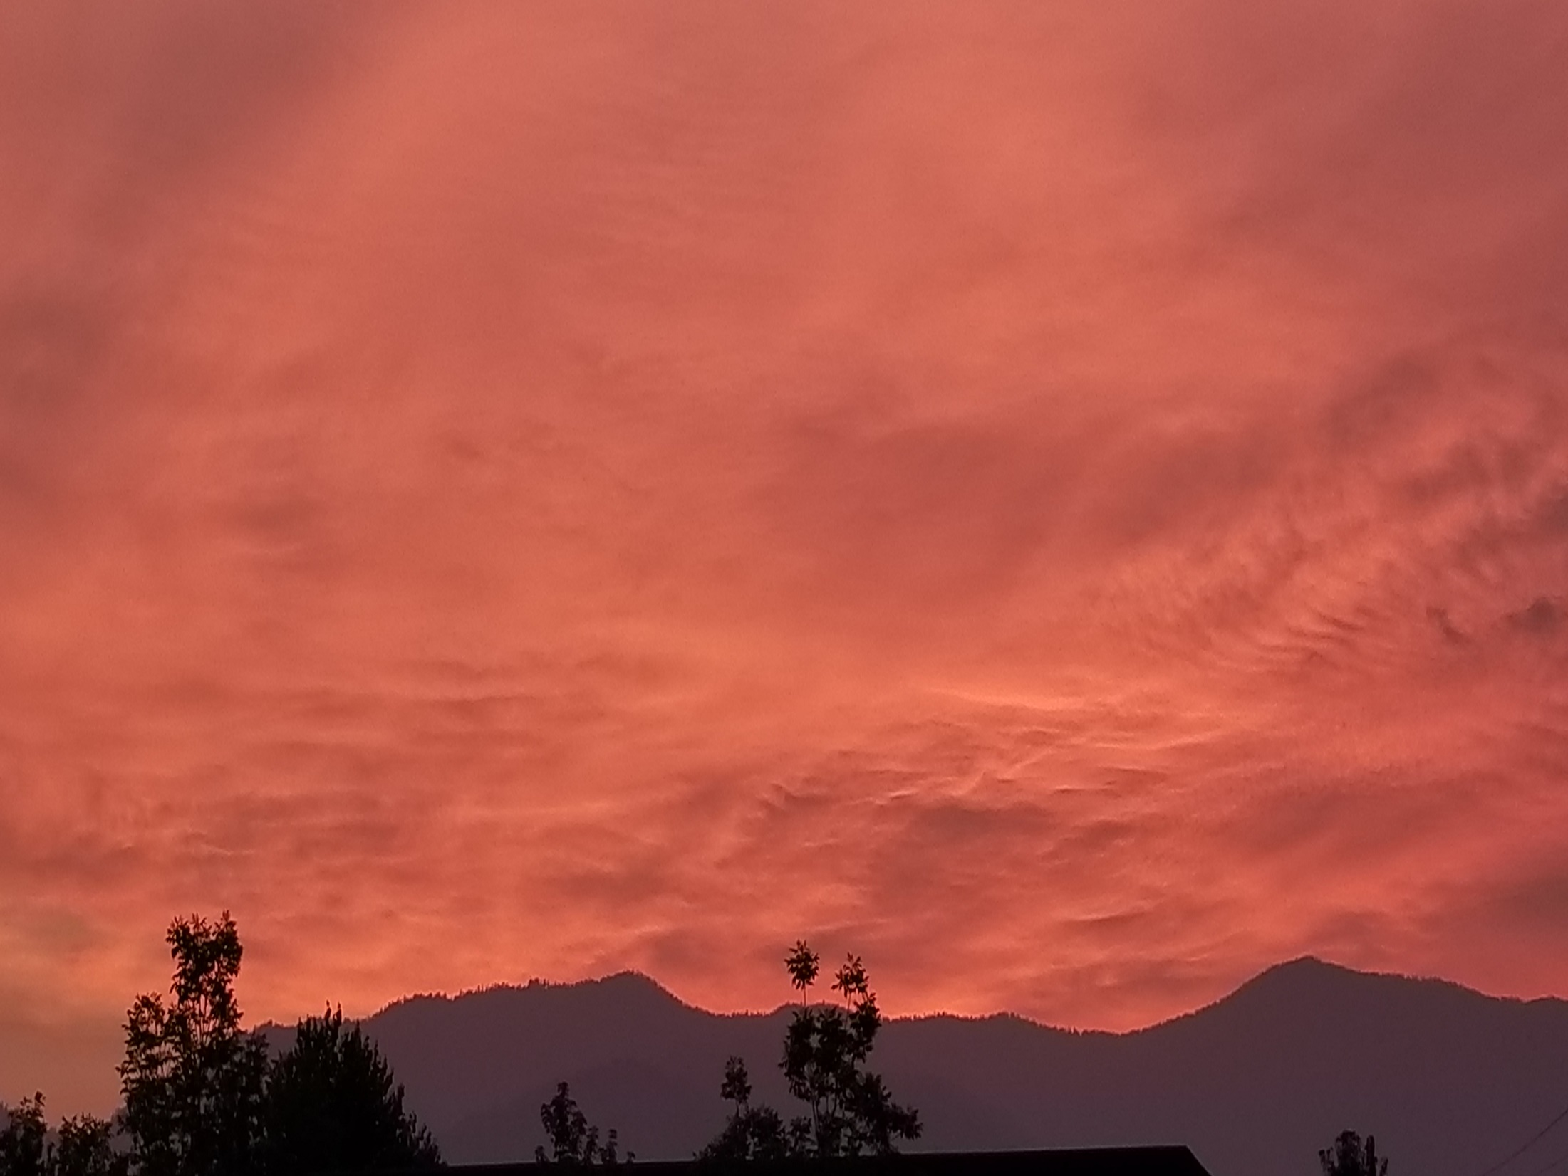
MESSIANIC MILESTONES
the Preaching and Teaching of the Messiah

Slide 2
When did He preach and teach?
Luke 2:42-47
Luke 3:23

Slide 3
Where did He preach and teach?
Matthew 5:1-2
Matthew 13:1-3
Matthew 13:54
Luke 21:37
Mark 8:27; 10:17
Luke 14:15

Slide 4
Whom did He preach and teach to?
Matthew 15:21-28; John 4:5-10
Matthew 22:41-45
Luke 15:1-7

Slide 5
How did He preach and teach?
Matthew 13:34
Matthew 17:10-12
Matthew 23:27-28; Mark 11:15-17
Luke 4:16-21

Slide 6
How did He preach and teach?
Mark 8:1-2
Luke 13:1-5
Luke 12:13-14
Matthew 7:29

Slide 7
What did He preach and teach?
Matthew 5:2-9
Matthew 10:38
Matthew 5:16
Luke 16:16
John 14:15
Matthew 5:21-26, 43-48
Matthew 5:27-28
Matthew 5:29-30
Matthew 5:31-32
Matthew 5:33-37

Slide 8
What did He preach and teach?
Matthew 5:38-42
Acts 20:35
Matthew 6:5-13
Matthew 6:14-15
Matthew 6:16-18
Matthew 6:19-21
Matthew 6:22-23
Matthew 6:24
Matthew 6:25-33
Matthew 7:1-6
Matthew 7:7-11
Matthew 7:12

Slide 9
What did He preach and teach?
Matthew 7:13-14
Matthew 7:15-20
Matthew 12:36-37
Matthew 12:48-50
Matthew 13:1-9
Matthew 15:1-9
Matthew 18:1-5
Matthew 18:15-20
Matthew 22:15-21
Matthew 22:23-33
Matthew 13:47-52
John 14:6

Slide 10
What did He preach and teach?
John 3:18; Matthew 10:32-33; 4:17; 28:19-20

Slide 11
Why did He preach and teach?
Luke 19:10
John 10:10_{b}

