Slide 1
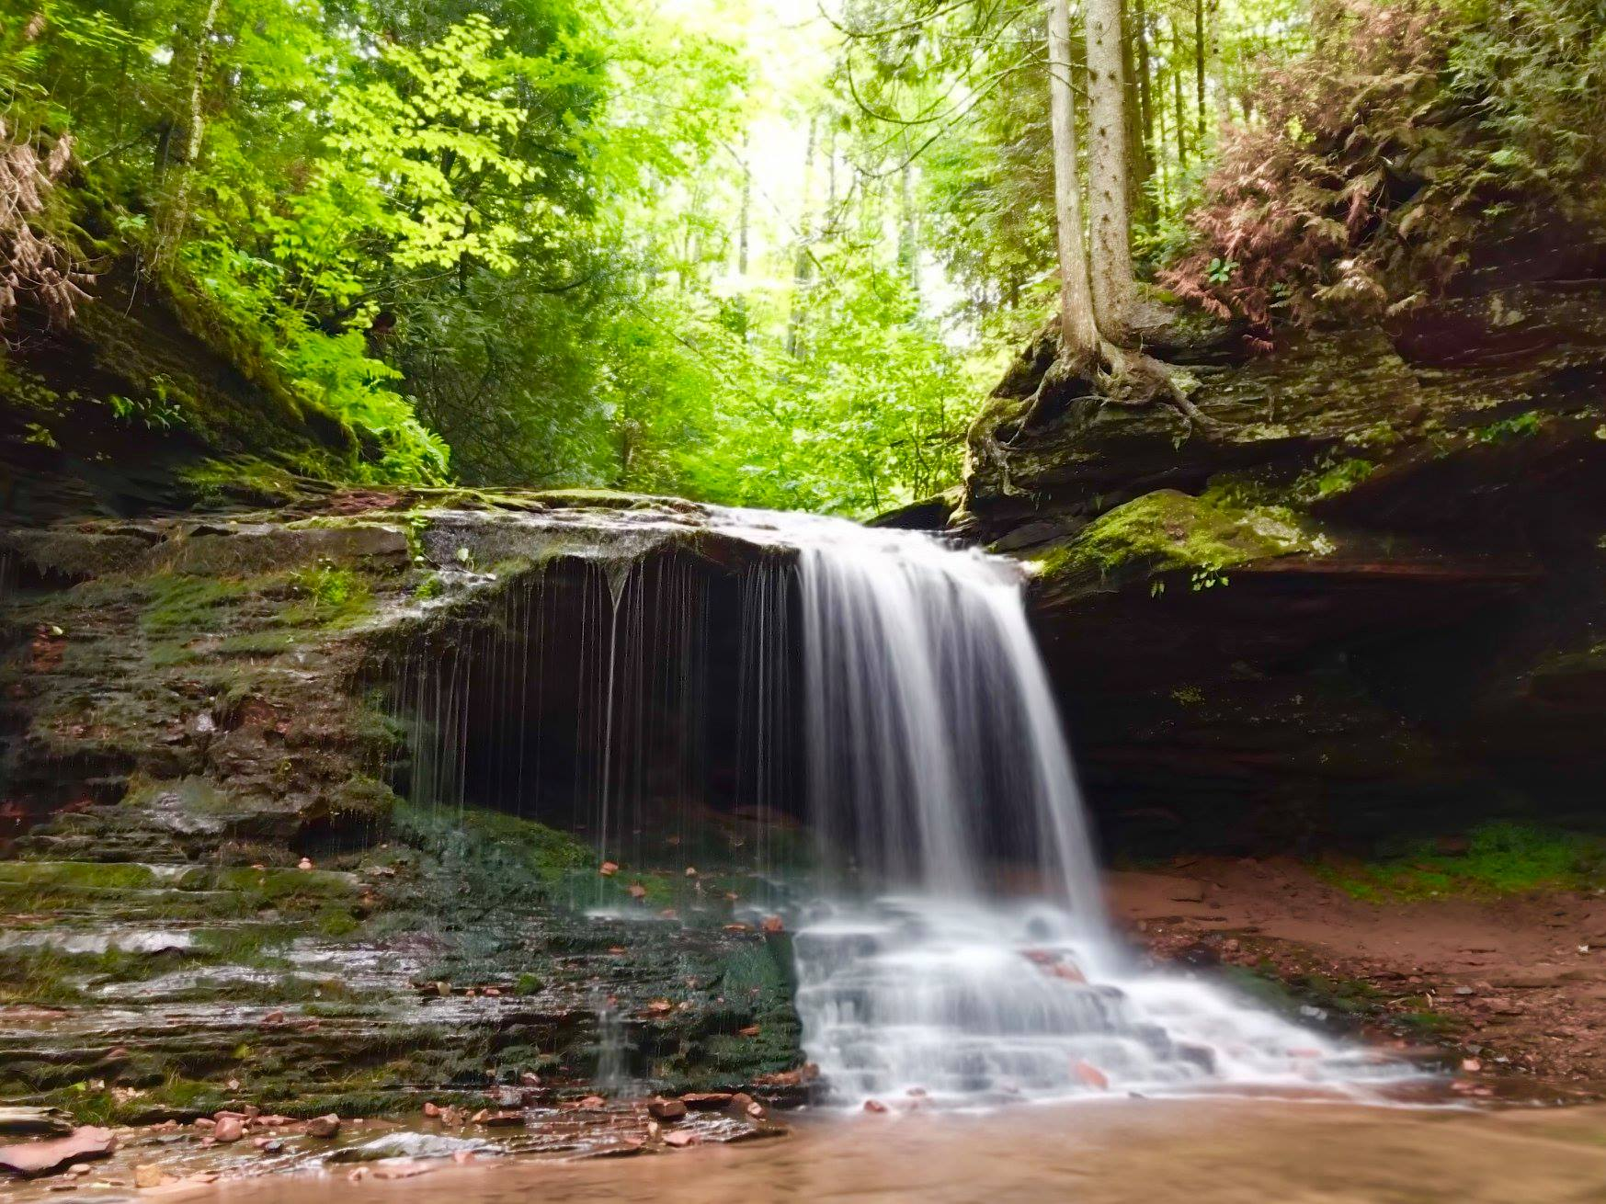
MESSIANIC MILESTONES
the Resurrection of the Messiah

Slide 2
the Resurrection of the Messiah
WHEN DID HE RISE?
Acts 10:39-40
Matthew 27:62-64
Matthew 12:40
John 2:18-21
John 20:1
John 20:19, 26
Acts 20:7

Slide 3
the Resurrection of the Messiah
WHO WITNESSED THE RESURRECTION?
Acts 10:40-41
Mark 16:9-14
Mark 16:1; Luke 24:10
John 20:1-18
Luke 24:13-35
John 20:19-29
Acts 1:21-23
1st Corinthians 15:1-8

Slide 4
the Resurrection of the Messiah
WHO WITNESSED THE RESURRECTION?
1st Corinthians 9:1; Acts 9:1-22
2nd Corinthians 13:1
Acts 3:6; Philippians 3:7-8
1st Corinthians 4:11; 2nd Corinthians 11:23-27
Luke 24:16; John 20:14, 25

Slide 5
the Resurrection of the Messiah
HOW DID HE RISE?
John 10:17-18
Acts 2:22-24
Matthew 28:2
John 20:6-7; 11:43-44

Slide 6
the Resurrection of the Messiah
WHY DID HE RISE?
Romans 10:1-4
Acts 10:36-42; 17:30-31
Hebrews 2:14-15
1st Peter 1:3, 20-21

Slide 7
the Resurrection of the Messiah
WHAT DID HE DO WHILE RESURRECTED?
Acts 1:1-3
1st John 1:1-3; John 20:20, 27; 21:1-14; Luke 24:30, 36-43
Matthew 28:18-20; Mark 16:15-18; Luke 24:44-49; Acts 1:4-8

