Slide 1
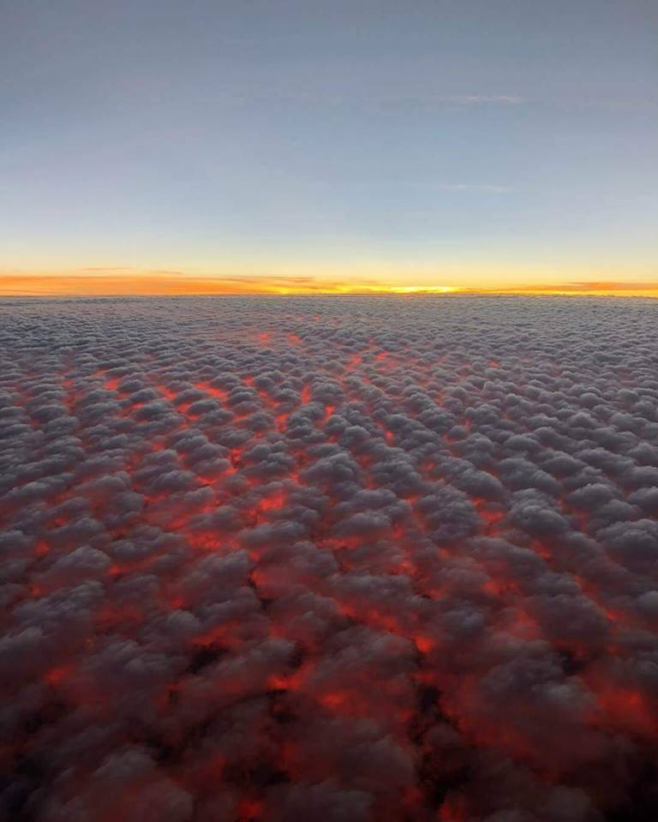
MESSIANIC MILESTONES
the Transfiguration of the Messiah

Slide 2
the Transfiguration of the Messiah
What was the Transfiguration?
Matthew 17:2
Mark 9:3
Romans 12:2

Slide 3
the Transfiguration of the Messiah
When did the Transfiguration happen?
Luke 9:28-29
James 5:16_{b}

Slide 4
the Transfiguration of the Messiah
Who appeared at the Transfiguration?
Luke 9:30-31
Deuteronomy 34:5-8; Jude 9
2nd Kings 2:9-14

Slide 5
the Transfiguration of the Messiah
Who appeared at the Transfiguration?
Matthew 17:4-8
Matthew 5:17-18; Luke 24:44
Luke 16:16

Slide 6
the Transfiguration of the Messiah
How did Peter react to the Transfiguration?
Luke 9:33; Mark 9:5-6
Proverbs 21:23; Ecclesiastes 5:2-3

Slide 7
the Transfiguration of the Messiah
Why did the Transfiguration happen?
2nd Peter 1:16-18
Luke 9:35; Hebrews 1:1-2

