Slide 1
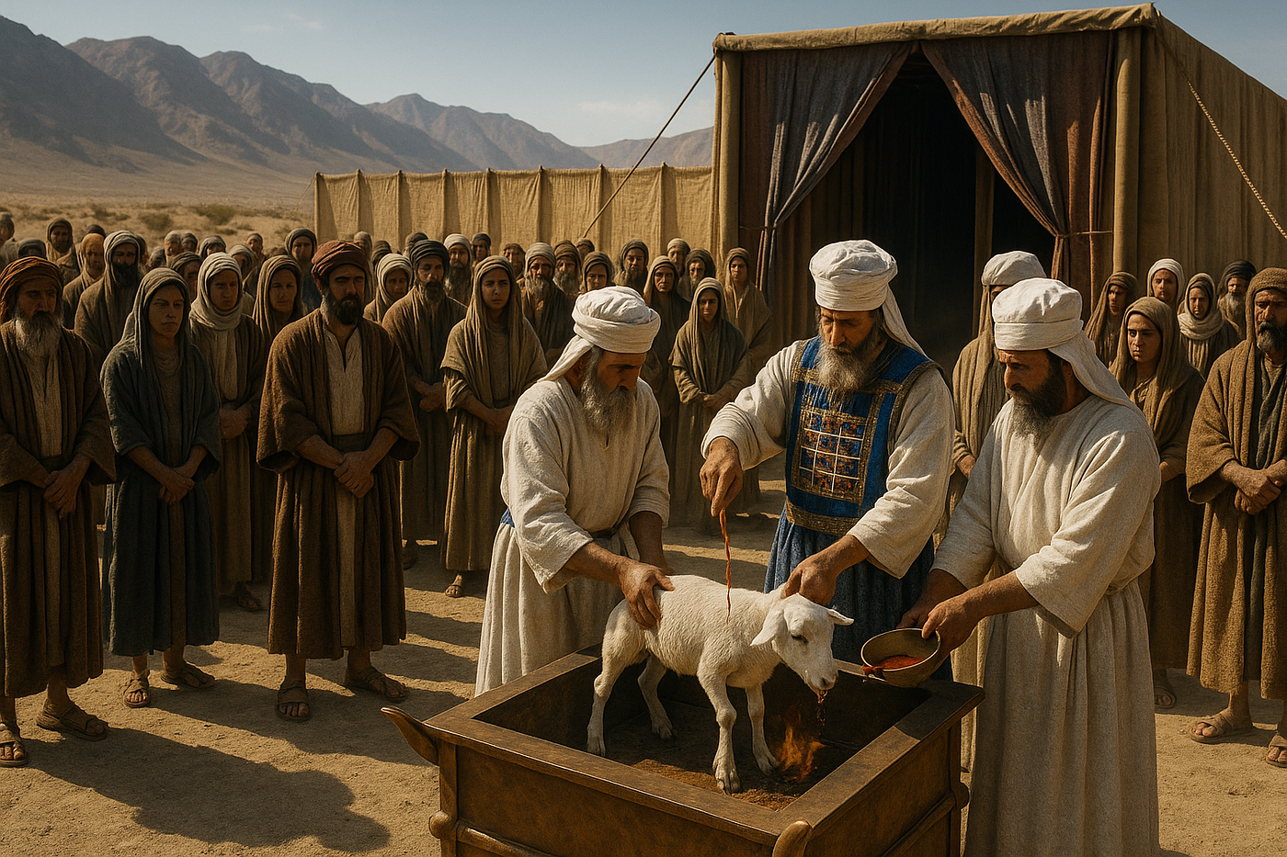
Truth or Tradition?
From Levitical Priesthood to a Nation of Priests

Slide 2

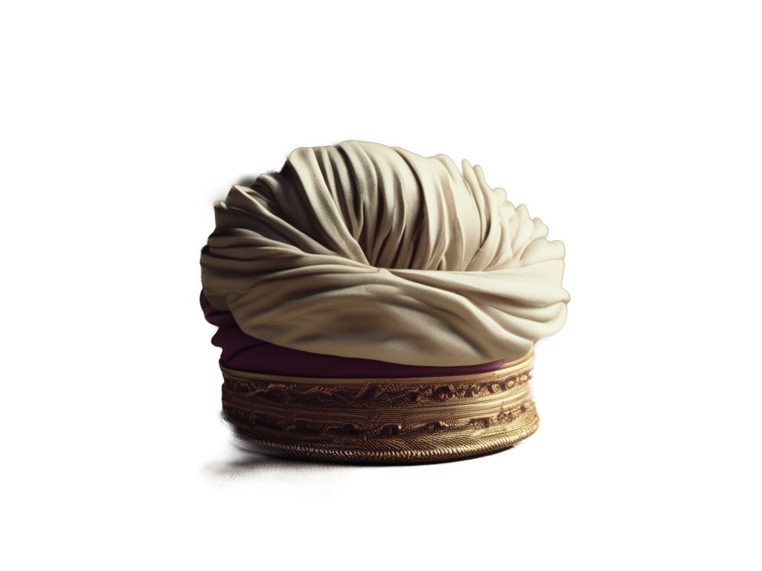
The Catholic Hierarchy: Priests
"The chosen people was constituted by God as "a kingdom of priests and a holy nation."; But within the people of Israel, God chose one of the twelve tribes, that of Levi, and set it apart for liturgical service; God himself is its inheritance. A special rite consecrated the beginnings of the priesthood of the Old Covenant. The priests are "appointed to act on behalf of men in relation to God, to offer gifts and sacrifices for sins." (CC, 1539)

Slide 3
The Catholic Hierarchy: Bishops
The Church teaches that "the bishops have by divine institution taken the place of the apostles as pastors of the Church, in such wise that whoever listens to them is listening to Christ and whoever despises them despises Christ and him who sent Christ." (CC, 862)

Slide 4
The Catholic Hierarchy: The Pope
The Pope, Bishop of Rome and “Peter's successor, is the perpetual and visible source and foundation of the unity both of the bishops and of the whole company of the faithful." (CC, 402)
"For the Roman Pontiff, by reason of his office as Vicar of Christ, and as pastor of the entire Church has full, supreme, and universal power over the whole Church, a power which he can always exercise unhindered." (CC, 882)

Slide 5
Is It Biblical?
“The modern priesthood is based on and is a continuance of the Levitical priesthood of the Old Testament. It is necessary for the ordained priests of this church to present the prayers and Eucharistic sacrifice to God on behalf of members of the church.”

Slide 6
Is It Biblical?
“The priests are appointed to act on behalf of men in relation to God, to offer gifts and sacrifices for sins.” (CC, 1539)
BUT… 1 Pet 2:5, 9
Rev 1:6
“The ministerial priesthood is a means by which Christ unceasingly builds up and leads his Church. For this reason it is transmitted by its own sacrament, the sacrament of Holy Orders. (CC, 1547).” (CC, 1539)

Slide 7
Should Priests Be Celibate?
“All the ordained ministers of the Latin Church, with the exception of permanent deacons, are normally chosen from among men of faith who live a celibate life and who intend to remain celibate ‘for the sake of the kingdom of heaven.’ Called to consecrate themselves with undivided heart to the Lord and to ‘the affairs of the Lord,’ they give themselves entirely to God and to men. Celibacy is a sign of this new life to the service of which the Church's minister is consecrated” (CC 1579)

Slide 8
Should Priests Be Celibate?
“Moreover, priestly celibacy is held in great honor in the Eastern Churches and many priests have freely chosen it for the sake of the Kingdom of God. In the East as in the West a man who has already received the sacrament of Holy Orders can no longer marry.” (CC 1580)
BUT… 1 Tim 4:1-5 1 Tim 3:1-2

Slide 9
Are Priests Sin-Forgivers?
“By Christ's will, the Church possesses the power to forgive the sins of the baptized and exercises it through bishops and priests normally in the sacrament of Penance.” (CC 986)
BUT… Mark 2:7
1 John 1:9
“Indeed bishops and priests, by virtue of the sacrament of Holy Orders, have the power to forgive all sins ‘in the name of the Father, and of the Son, and of the Holy Spirit.’”
(CC 1461)

Slide 10
Truth or Tradition?
From Levitical Priesthood to a Nation of Priests

