Slide 1
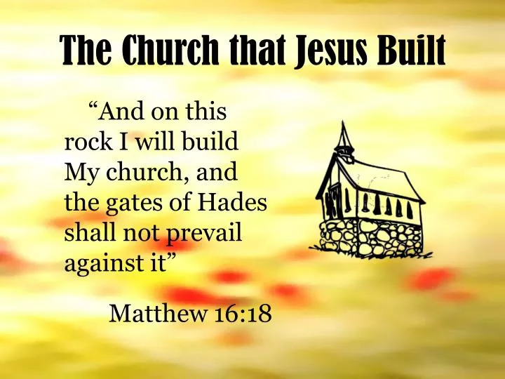

Slide 2
The Church that Jesus Built
John17:17 God’s Word is Truth!
2 Corinthians 8:12 Have a willing mind.
Ephesians 4:15 ; Romans 1:16 The truth IS love. Truth is Power!
2 Timothy 3:16 “All Scripture is given by inspiration of God…”
Scripture is God-breathed

Slide 3
What is the right church?
2 Peter 3: 14-16 People twist the scriptures
Acts 20:28-31 Beware of wolves and false teachers
1 Corinthians 14:33 God is NOT the author of confusion
Christ’s church

Slide 4
Where does our name come from?
Rom 16:16 churches of Christ
Matthew 16:18 My church
Acts 2:47 Lord added to the church daily
Acts 20:28 shepherd the church of God which He purchased with His own blood.
Ephesians 1:22,23 Church = Body
Ephesians 4:4 1 Body = 1 church

Slide 5
Where did all of these “churches” come from?
A Denomination is:
Unscriptural—has no Biblical support
Anti-scriptural—goes against the idea of the Bible
Post-scriptural- came into existence after Bible was already written

Slide 6
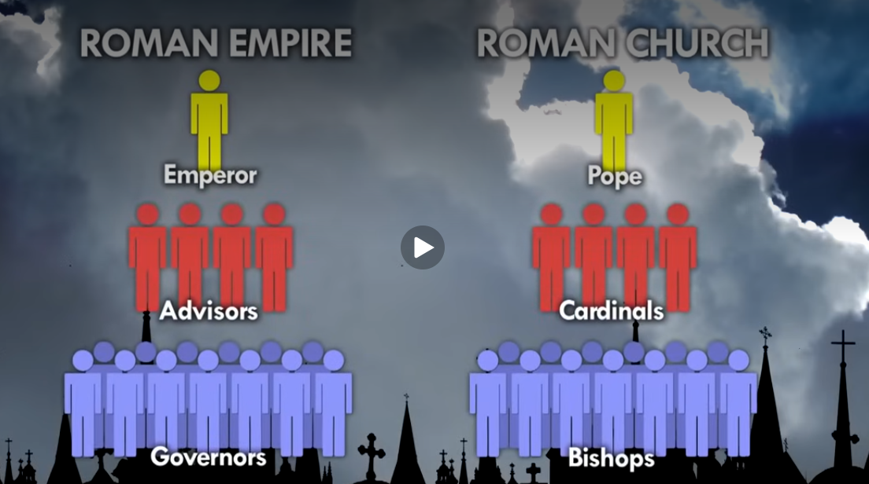
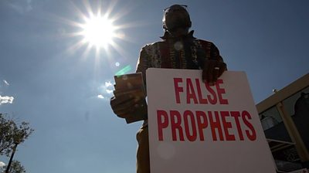
Counterfeit Churches (not exhaustive)
45,000 different varieties of false denominations (2024)
110 A.D. Ignatius of Antioch
325/606 A.D. Catholic
622 A.D. Islam
1054 A.D Greek Orthodox
1500’s Lutheran (protestant reformation)
Presbyterian
1607 John Smyth
1739 Methodist
Seven Day Adventist
1800 Jehovah Witness
1901 Pentecostal

Slide 7
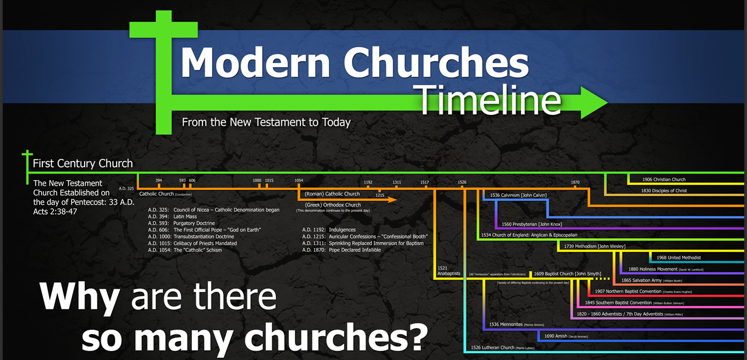

Slide 8

Romans 1:6-7
1 Corinthians 1:1-2,9
1 Thessalonians 2:12
2 Thessalonians 2:13-14
2 Timothy 1:9

Slide 9
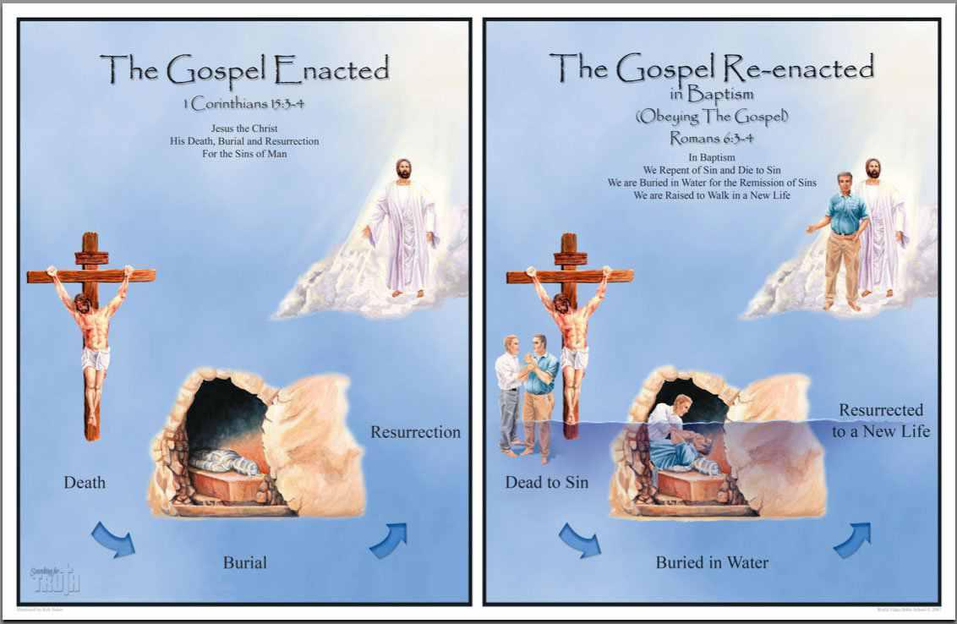

Slide 10
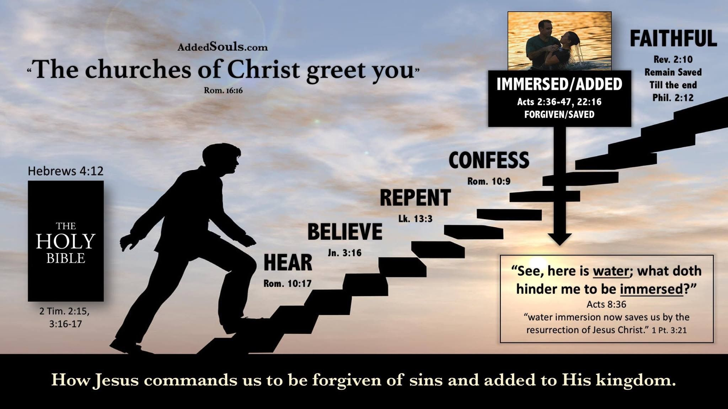

Slide 11


