Slide 1
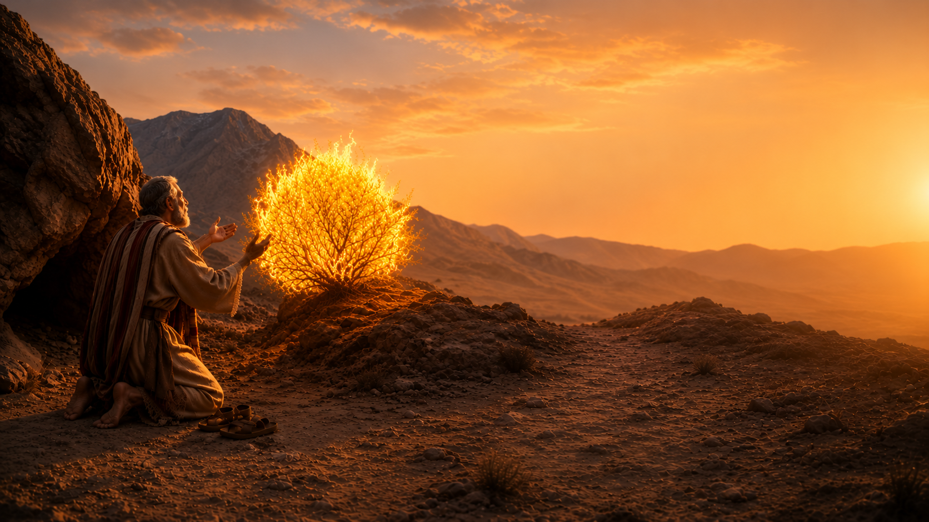
MOSES’S
EXCUSES

Slide 2
MOSES’S EXCUSES
Exodus 3:1-10

Slide 3
MOSES’S EXCUSES
“Who Am I?””
Exodus 3:11-12
Romans 8:31;
Deuteronomy 31:6
Matthew 28:19-20
2nd Corinthians 3:5-6

Slide 4
MOSES’S EXCUSES
“What Shall I Say?””
Exodus 3:13-15
Colossians 4:6;
2nd Timothy 2:15;
1st Peter 3:15
1st Peter 4:11;
1st Corinthians 2:2

Slide 5
MOSES’S EXCUSES
“Suppose They Will Not Believe Me”
Exodus 4:1-9
Romans 10:17;
John 20:30-31
John 12:37-41

Slide 6
MOSES’S EXCUSES
“I Am Not Eloquent”
Exodus 4:10-12
Acts 7:22
1st Corinthians 2:1-5
Romans 16:18

Slide 7
MOSES’S EXCUSES
“Please Send… Whomever Else You May Send”
Exodus 4:13-17
1st Peter 2:9-10
Mark 16:15-16

