Slide 1


Slide 2
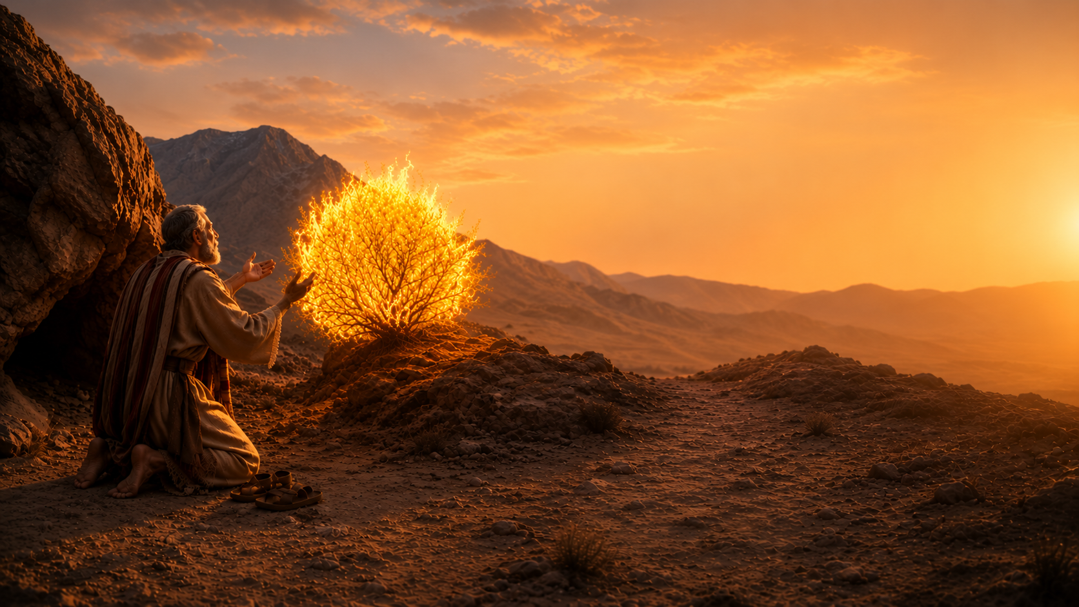
Moses at Mount Horeb
Exodus 3:1-17
Matthew 28:18-20
Acts 4:10-12

Slide 3
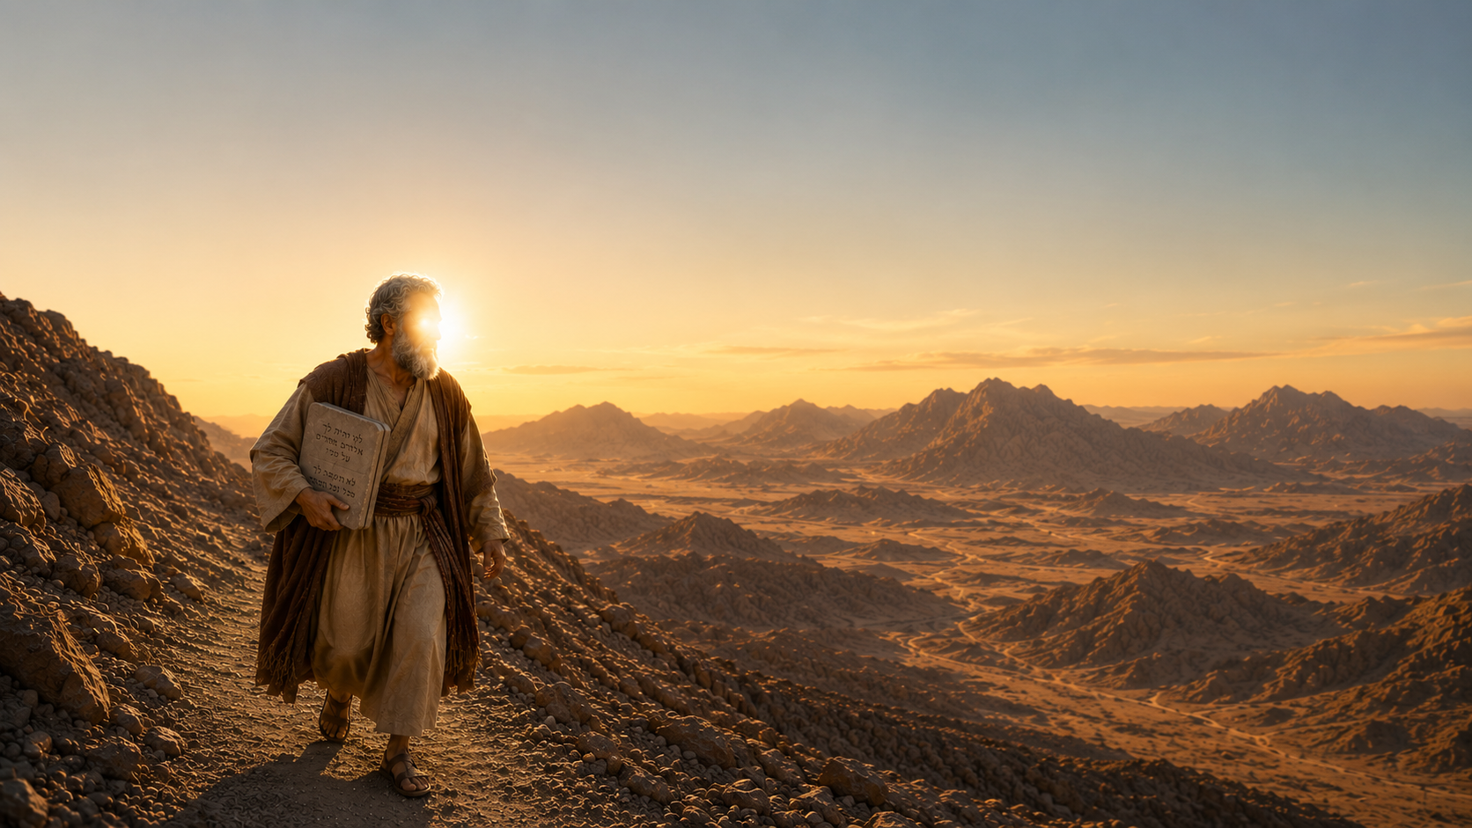
Moses at Mount Sinai
Exodus 19:1-25
Psalm 89:7
Hebrews 12:28-29
Exodus 31:18
Hebrews 7:12
1st Corinthians 9:21

Slide 4
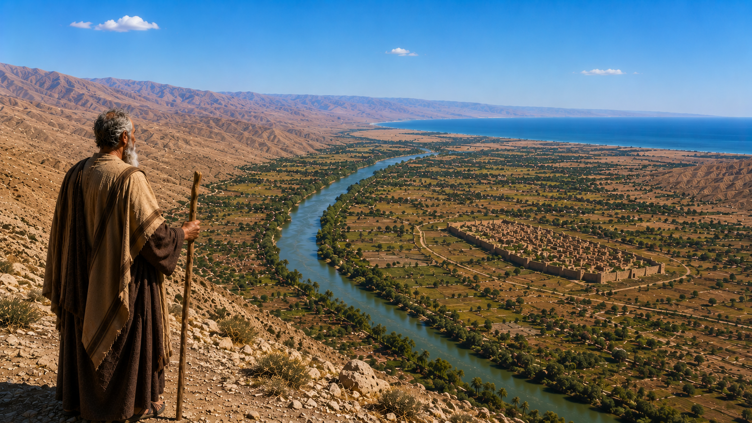
Moses at Mount Nebo
Deuteronomy 34:1-8
1st Corinthians 6:9-10
2nd Samuel 12:13-14
Jude 9;
Deuteronomy 29:29

Slide 5
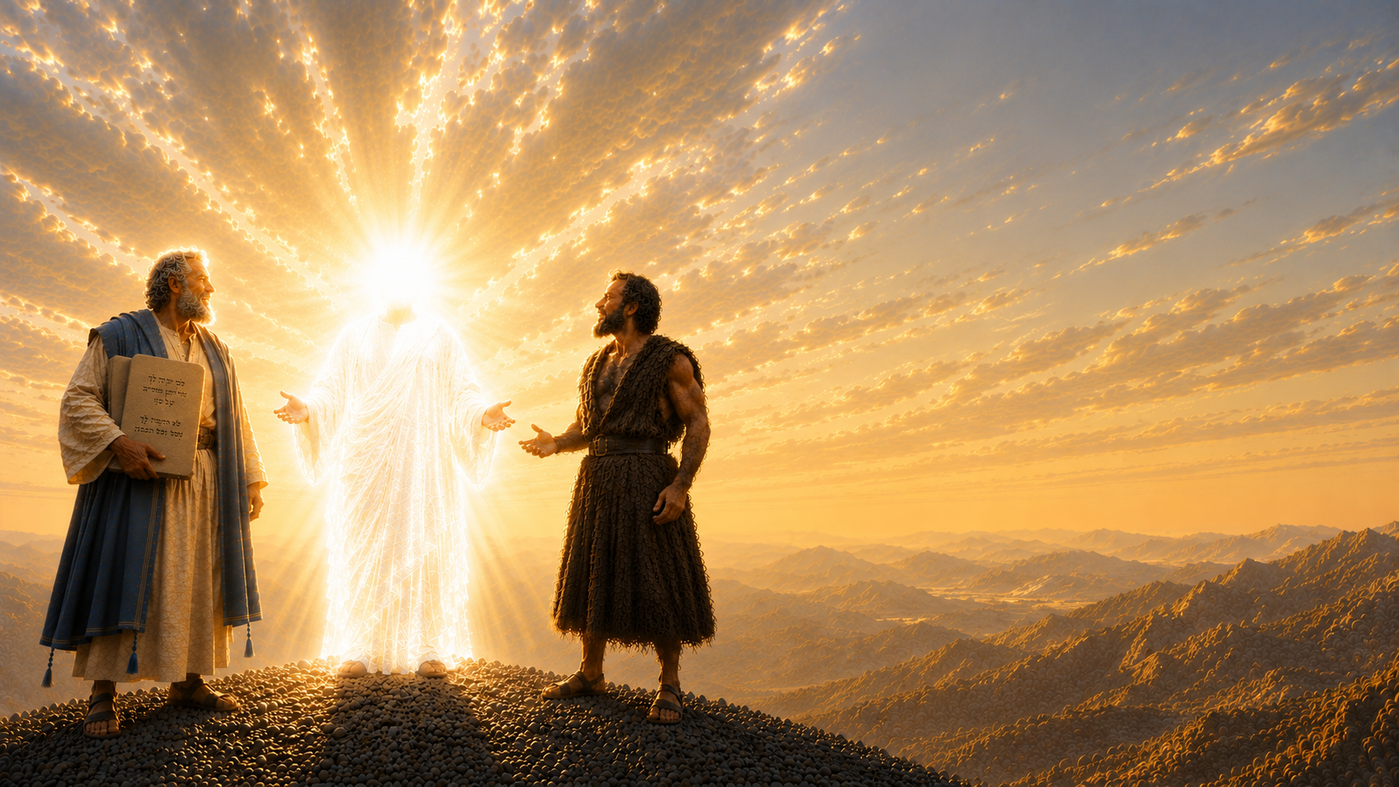
Moses at the Holy Mountain
Mark 9:2-8;
2nd Peter 1:16-18
Deuteronomy 34:10-12
Deuteronomy 18:15-19
Acts 3:22-26

