Slide 1
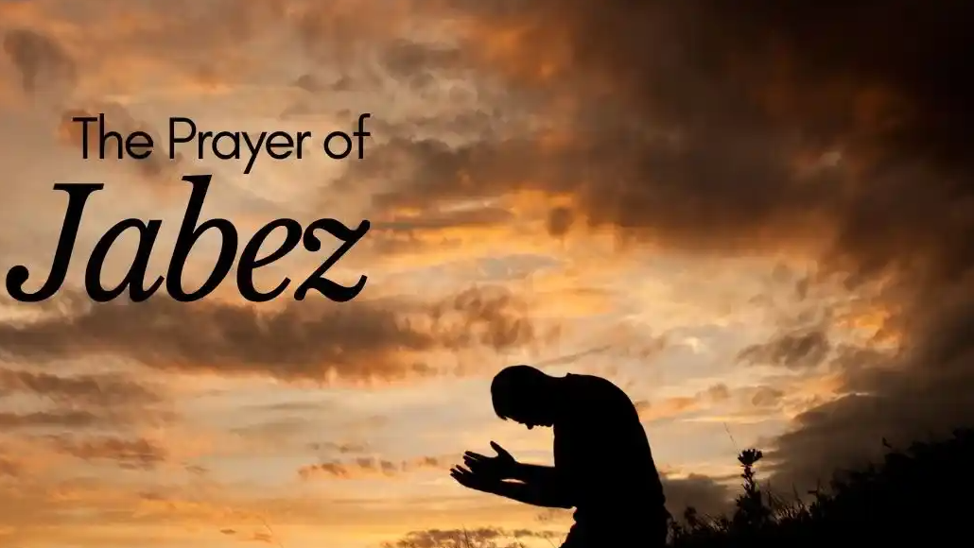
And Jabez called on the God of Israel, saying, Oh that thou wouldest bless me indeed, and enlarge my coast, and that thine hand might be with me, and that thou wouldest keep me from evil, that it may not grieve me!
1 Chronicles 4:10

Slide 2
“Oh, That Thou Would Bless Me Indeed”
Genesis 32:24–26, 29
James 1:17
Acts 3:26
Ephesians 1:3
Philippians 4:19

Slide 3
“Enlarge My Coast”
I Timothy 6:6–10
I Timothy 6:17–21
Ephesians 4:28
I Corinthians 16:2

Slide 4
“Enlarge My Coast”
(Not Just Physical)
John 10:10
II Peter 1:11
Ephesians 3:17–21
Enlargement ALWAYS Brings Responsibility
(Luke 12:41-48)

Slide 5
“That Thine Hand Might Be With Me”
Ephesians 3:16
Philippians 4:13
I Peter 5:6–7
Psalm 37:23–24

Slide 6
“That Thou Would Keep Me From Evil, That It May Not Grieve Me”
Deuteronomy 32:15
Deuteronomy 31:20
James 1:12–13
Matthew 6:13

Slide 7
“And God Granted Him What He Requested”
Matthew 7:7–11(Ask and you shall receive)
James 4:3 (Ask with the correct motives)

Slide 8
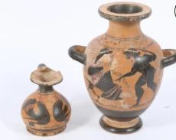
1 Corinthians 10:13 (He will not let you be tempted beyond your ability)
GOD FILLS ACCORDING TO CAPACITY

Slide 9
Hear the word (Rom. 10:17)
Believe in Christ (John 8:24)
Repent of sins (Luke 13:3)
Confess His name (Matt. 10:32-33; Rom. 10:9-10)
Be baptized into Christ (Mark 16:16; Rom. 6:3-5; Col. 2:12; Galatians 3:26-27)
Live faithfully until death (1 Cor. 15:58; Rev. 2:10)

