Slide 1
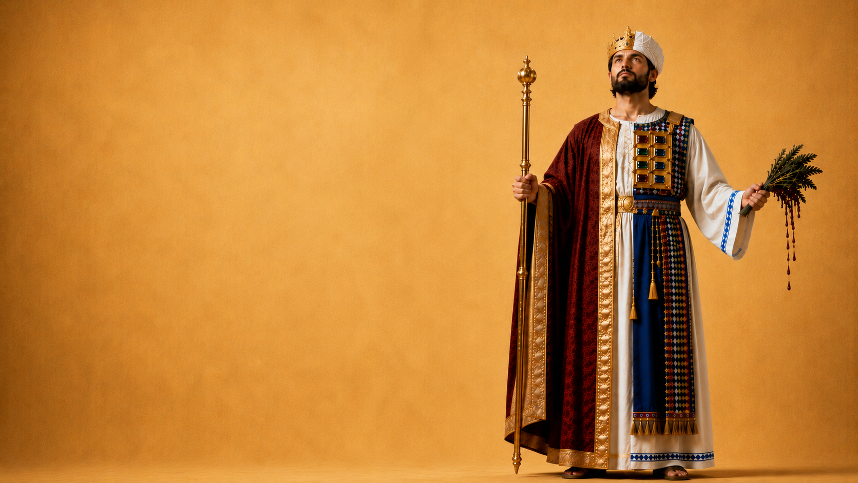
PSALM 110

Slide 2
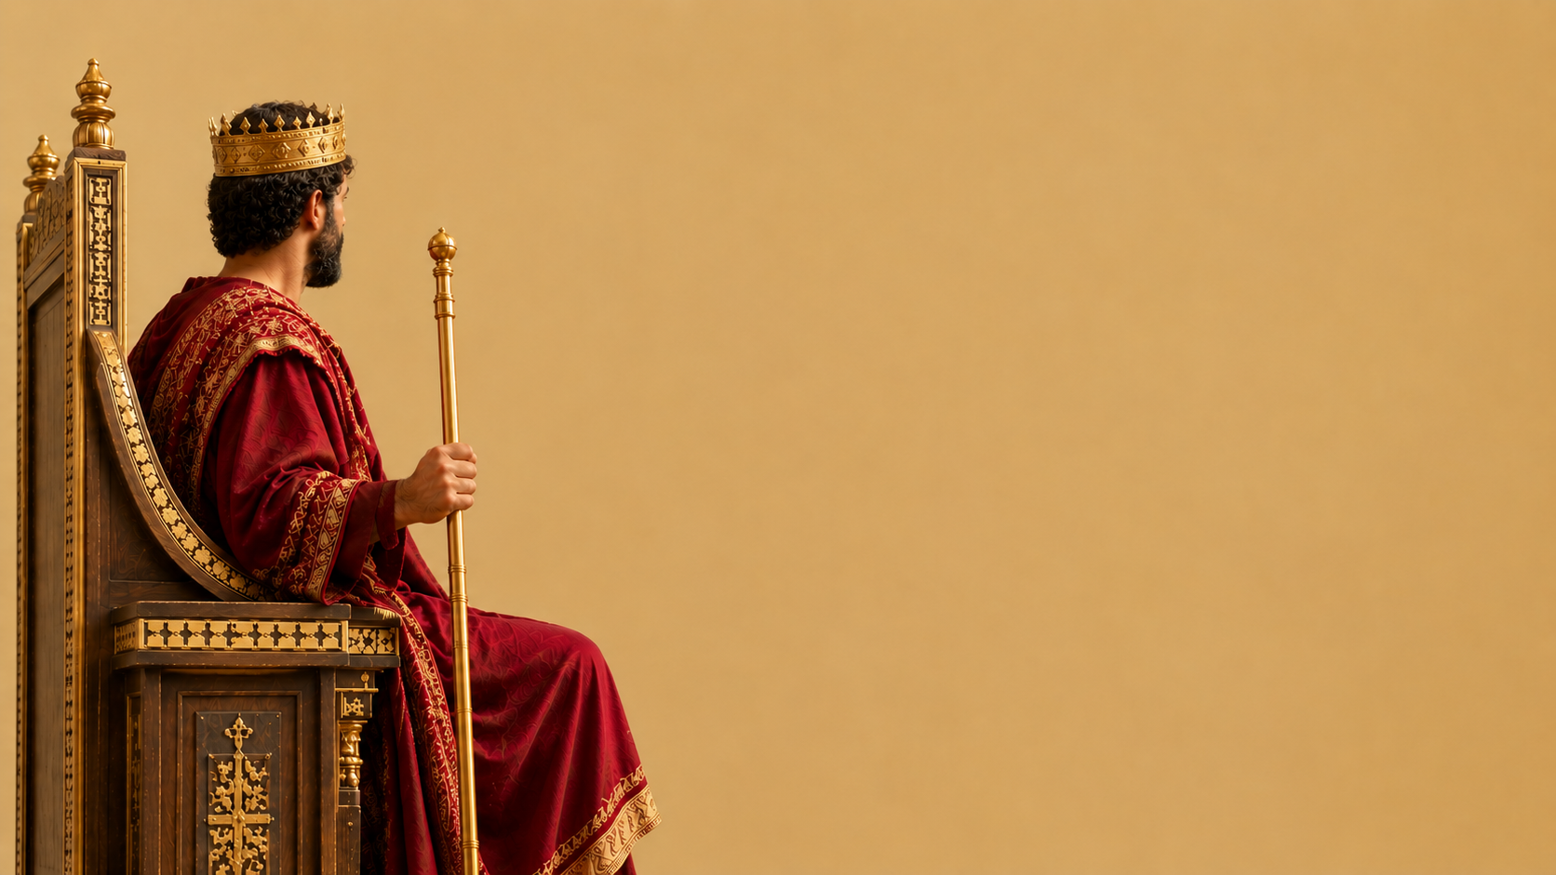
PSALM 110
“A psalm of David” (0)
Mark 12:36
2nd Peter 1:20-21

Slide 3
PSALM 110
“Jehovah said to my Lord” (1)
Matthew 22:41-46
2nd Samuel 7:12-17
Romans 1:3-4

Slide 4
PSALM 110
“Sit at My right hand” (1)
Acts 2:32-36
Mark 16:19
Hebrews 10:11-12
Acts 5:30-31
Colossians 3:1-2

Slide 5
PSALM 110
“Till I make Your enemies Your footstool” (1)
Ephesians 1:17-23
Hebrews 1:13-14
Hebrews 10:12-13

Slide 6
PSALM 110
“Rule in the midst of Your enemies!” (2)
1st Corinthians 15:24-26
1st Peter 5:8
Matthew 13:24-30, 36-43

Slide 7
PSALM 110
“Your people shall be volunteers in the day of Your power” (3)
Acts 2:40-41
Revelation 22:17

Slide 8

PSALM 110
“You are a Priest forever according to the order of Melchizedek” (4)
Genesis 14:18-20
Hebrews 6:18-7:28

Slide 9
PSALM 110
“The Lord is at Your right hand; He shall execute kings in the day of His wrath. He shall judge among the nations, He shall fill the places with dead bodies, He shall execute the heads of many countries.” (5-6)
Matthew 25:31-34,41
Revelation 20:12

Slide 10
PSALM 110
“He shall drink of the brook by the wayside; Therefore He shall lift up the head” (7)
Psalm 27:6
1st Chronicles 29:11

