Slide 1
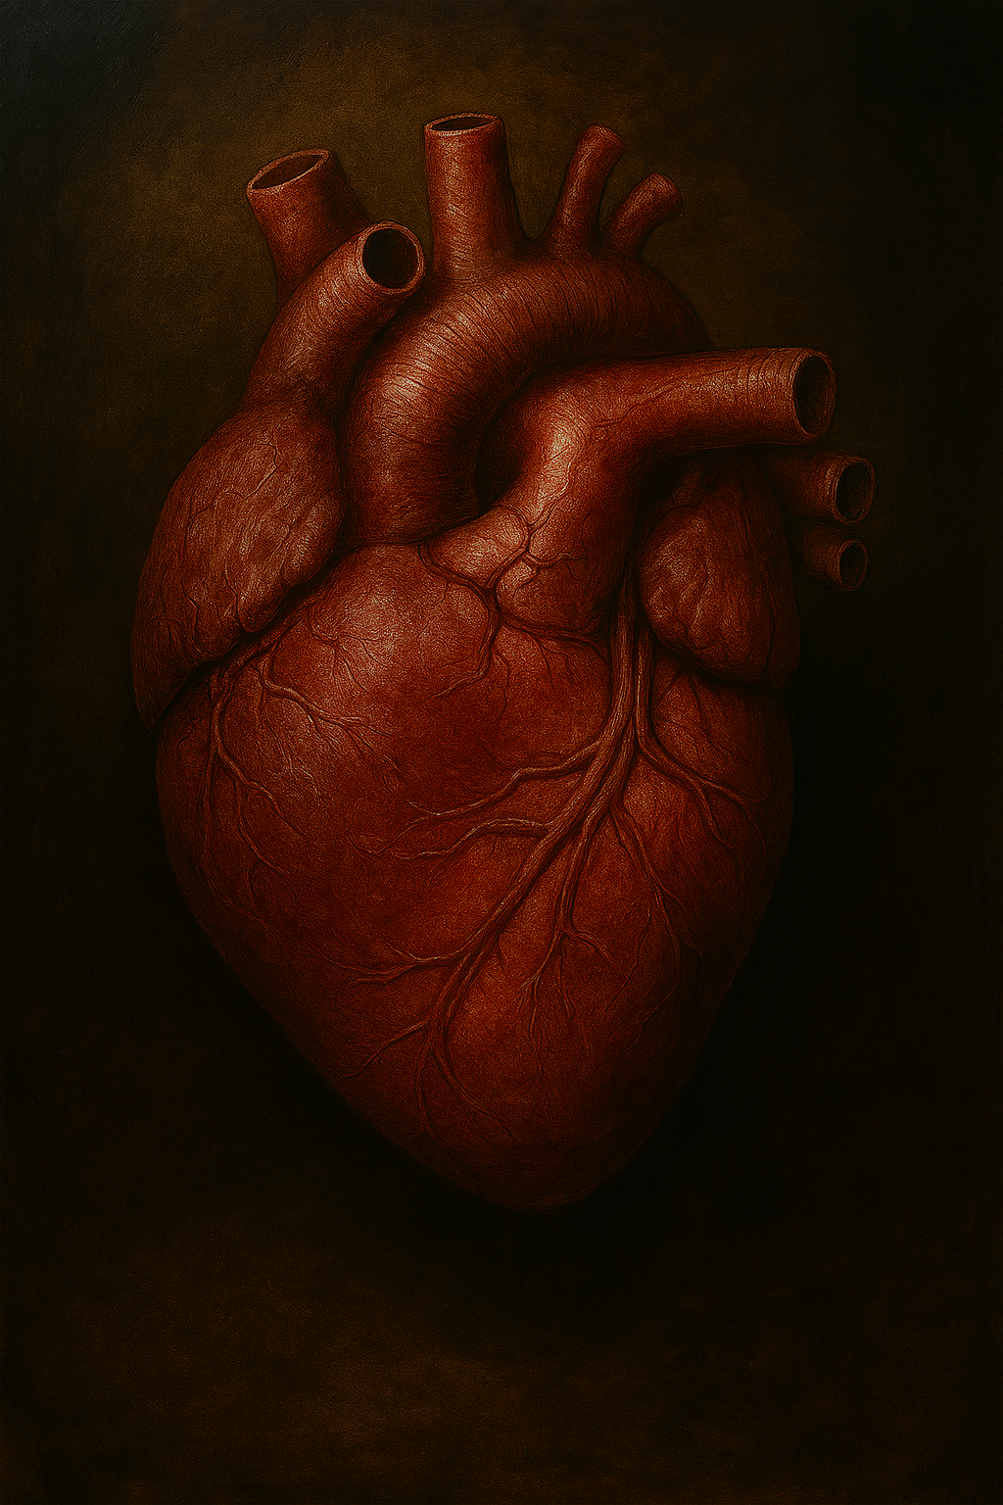
Restoring a Heart of Flesh
Ezekiel 11:17-21
Notes:
Ezekiel 11
17 Therefore say, ‘Thus says the Lord God, “I will gather you from the peoples and assemble you out of the countries among which you have been scattered, and I will give you the land of Israel.”’ 18 When they come there, they will remove all its detestable things and all its abominations from it. 19 And I will give them one heart, and put a new spirit within [j]them. And I will take the heart of stone out of their flesh and give them a heart of flesh, 20 that they may walk in My statutes and keep My ordinances and do them. Then they will be My people, and I shall be their God. 21 [k]But as for those whose hearts go after their detestable things and abominations, I will bring their conduct down on their heads,” declares the Lord God.

Slide 2
A Hard Heart Develops Over Time

Slide 3
A Hard Heart Develops Over Time
From Repeated Sin

Slide 4
Hebrew 10
26 For if we go on sinning willfully after receiving the knowledge of the truth, there no longer remains a sacrifice for sins,

Slide 5
1 John 3
8 the one who practices sin is of the devil; for the devil has sinned from the beginning. The Son of God appeared for this purpose, to destroy the works of the devil. 9 No one who is born of God practices sin, because His seed abides in him; and he cannot sin, because he is born of God.
Notes:
“Practices” implies prolonging or a habitual nature of sinning
4 Everyone who practices sin also practices lawlessness; and sin is lawlessness. 5 You know that He appeared in order to take away sins; and in Him there is no sin. 6 No one who abides in Him sins; no one who sins has seen Him or [b]knows Him. 7 Little children, make sure no one deceives you; the one who practices righteousness is righteous, just as He is righteous;
10 By this the children of God and the children of the devil are obvious: [f]anyone who does not practice righteousness is not of God, nor the one who does not love his brother.

Slide 6
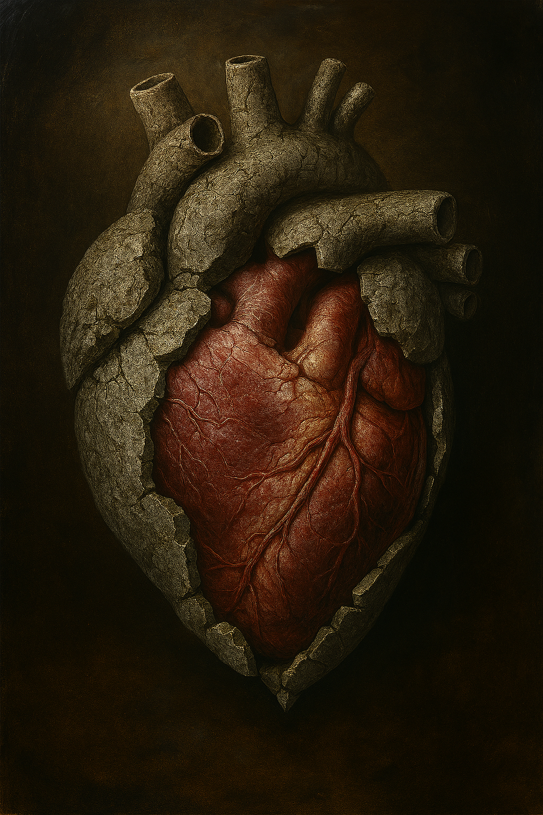
A Hard Heart Develops Over Time
From Repeated Sin
From Repeated Denial

Slide 7
1 John 1
8 If we say that we have no sin, we are deceiving ourselves and the truth is not in us.
Notes:
Denial of sin mocks the sacrifice that was made on our behalf.
Romans 3:23 for all have sinned and fall short of the glory of God, 24 being justified as a gift by His grace through the redemption which is in Christ Jesus; 25 whom God displayed publicly as a [n]propitiation [o]in His blood through faith. This was to demonstrate His righteousness, [p]because in the forbearance of God He passed over the sins previously committed;

Slide 8
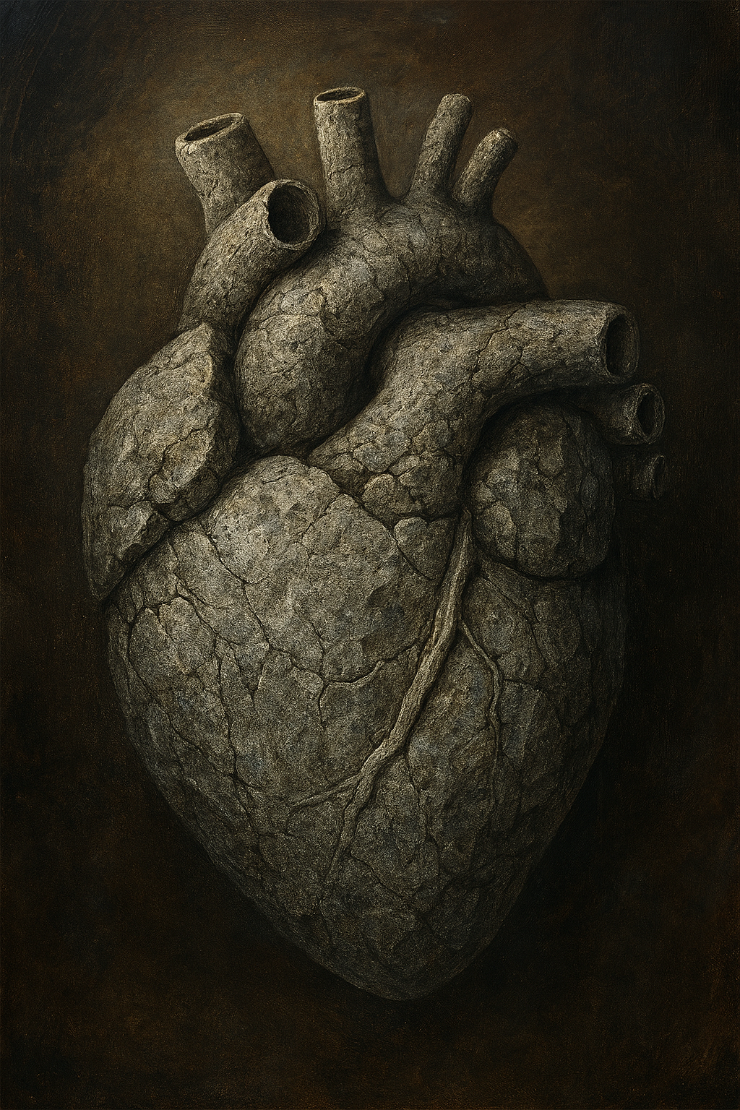
A Hard Heart Develops Over Time
From Repeated Sin
From Repeated Denial
From Prolonged Company With Stone Hearts

Slide 9
1 Corinthians 15
33 Do not be deceived: “Bad company corrupts good morals.”

Slide 10
1 Corinthians 6
9 Or do you not know that the unrighteous will not inherit the kingdom of God? Do not be deceived; neither fornicators, nor idolaters, nor adulterers, nor effeminate, nor homosexuals, 10 nor thieves, nor the covetous, nor drunkards, nor revilers, nor swindlers, will inherit the kingdom of God.

Slide 11
1 Corinthians 6
11 Such were some of you; but you were washed, but you were sanctified, but you were justified in the name of the Lord Jesus Christ and in the Spirit of our God.

Slide 12
1 Corinthians 6
11 Such were some of you; but you were washed, but you were sanctified, but you were justified in the name of the Lord Jesus Christ and in the Spirit of our God.
Notes:
“Were” is the key term, but if we are still in that crowd & committing those sins, then this verse can’t apply to us, it turns from “were” to “are” . . .

Slide 13
1 Corinthians 6
11 Such were some of you; but you were washed, but you were sanctified, but you were justified in the name of the Lord Jesus Christ and in the Spirit of our God.

Slide 14
1 Corinthians 6
are
11 Such were some of you; but you were washed, but you were sanctified, but you were justified in the name of the Lord Jesus Christ and in the Spirit of our God.

Slide 15
1 Corinthians 6
are
11 Such were some of you; but you were washed, but you were sanctified, but you were justified in the name of the Lord Jesus Christ and in the Spirit of our God.

Slide 16
1 Corinthians 6
are
11 Such were some of you; but you were washed, but you were sanctified, but you were justified in the name of the Lord Jesus Christ and in the Spirit of our God.

Slide 17
1 Corinthians 5
11 But actually, I wrote to you not to associate with any so-called brother if he is an immoral person, or covetous, or an idolater, or a reviler, or a drunkard, or a swindler—not even to eat with such a one.
Notes:
9 I wrote you in my letter not to associate with immoral people; 10 I did not at all mean with the immoral people of this world, or with the covetous and swindlers, or with idolaters, for then you would have to go out of the world.

Slide 18
A Hardened Heart

Slide 19
A Hardened Heart
Resists Conviction & Transformation

Slide 20
Jeremiah 18
12 But they will say, ‘It’s hopeless! For we are going to follow our own plans, and each of us will act according to the stubbornness of his evil heart.’
Notes:
Context: Potter & the Clay. God telling Jeremiah what the answer of the people will be to their condemnation.

Slide 21
Ephesians 4
17 So this I say, and affirm together with the Lord, that you walk no longer just as the Gentiles also walk, in the futility of their mind, 18 being darkened in their understanding, excluded from the life of God because of the ignorance that is in them, because of the hardness of their heart;

Slide 22
Ephesians 4
19 and they, having become callous, have given themselves over to sensuality for the practice of every kind of impurity with greediness.

Slide 23
A Hardened Heart
Resists Conviction & Transformation
Leads to Spiritual Blindness

Slide 24
2 Corinthians 4
3 And even if our gospel is veiled, it is veiled to those who are perishing, 4 in whose case the god of this world has blinded the minds of the unbelieving so that they might not see the light of the gospel of the glory of Christ, who is the image of God.

Slide 25
2 Corinthians 4
3 And even if our gospel is veiled, it is veiled to those who are perishing, 4 in whose case the god of this world has blinded the minds of the unbelieving so that they might not see the light of the gospel of the glory of Christ, who is the image of God.

Slide 26
Revelation 3
17 Because you say, “I am rich, and have become wealthy, and have need of nothing,” and you do not know that you are wretched and miserable and poor and blind and naked,
Notes:
Context: letter to the church & Laodicea(lukewarm)

Slide 27
A Hardened Heart
Resists Conviction & Transformation
Leads to Spiritual Blindness
Unchanged, Leads to Condemnation

Slide 28
Hebrew 10
27 but a terrifying expectation of judgment and the fury of a fire which will consume the adversaries. 28 Anyone who has set aside the Law of Moses dies without mercy on the testimony of two or three witnesses.
Notes:
26 For if we go on sinning willfully after receiving the knowledge of the truth, there no longer remains a sacrifice for sins,

Slide 29
Hebrew 10
29 How much severer punishment do you think he will deserve who has trampled under foot the Son of God, and has regarded as unclean the blood of the covenant by which he was sanctified, and has insulted the Spirit of grace? 30 For we know Him who said, “Vengeance is Mine, I will repay.” And again, “The Lord will judge His people.”
Notes:
26 For if we go on sinning willfully after receiving the knowledge of the truth, there no longer remains a sacrifice for sins,

Slide 30
Hebrew 10
31 It is a terrifying thing to fall into the hands of the living God.
Notes:
26 For if we go on sinning willfully after receiving the knowledge of the truth, there no longer remains a sacrifice for sins,

Slide 31
A Heart of Flesh

Slide 32
A Heart of Flesh
Requires Humility

Slide 33
1 John 1
9 If we confess our sins, He is faithful and righteous to forgive us our sins and to cleanse us from all unrighteousness. 10 If we say that we have not sinned, we make Him a liar and His word is not in us.
Notes:
8 If we say that we have no sin, we are deceiving ourselves and the truth is not in us.

Slide 34
James 4
8 Draw near to God and He will draw near to you. Cleanse your hands, you sinners; and purify your hearts, you double-minded. 9 Be miserable and mourn and weep; let your laughter be turned into mourning and your joy to gloom. 10 Humble yourselves in the presence of the Lord, and He will exalt you.

Slide 35
A Heart of Flesh
Requires Humility
Requires being Receptive to God

Slide 36
Psalm 95
7 . . .Today, if you would hear His voice,
8 Do not harden your hearts, . . .
Notes:
7 For He is our God,
And we are the people of His [d]pasture and the sheep of His hand.
Today, [e]if you would hear His voice,
8 Do not harden your hearts, as at [f]Meribah,
As in the day of [g]Massah in the wilderness,
9 “When your fathers tested Me,
They tried Me, though they had seen My work.
10 “For forty years I loathed that generation,
And said they are a people who err in their heart,
And they do not know My ways.
11 “Therefore I swore in My anger,
Truly they shall not enter into My rest.”

Slide 37
James 1
21 Therefore, putting aside all filthiness and all that remains of wickedness, in humility receive the word implanted, which is able to save your souls.

Slide 38
1 Thessalonians 2
13 For this reason we also constantly thank God that when you received the word of God which you heard from us, you accepted it not as the word of men, but for what it really is, the word of God, which also performs its work in you who believe.
Notes:
Paul commends the church in Thessalonica for their receptiveness.

Slide 39
A Heart of Flesh
Requires Humility
Requires being Receptive to God
Requires the Willingness to Obey

Slide 40
Romans 6
16 Do you not know that when you present yourselves to someone as slaves for obedience, you are slaves of the one whom you obey, either of sin resulting in death, or of obedience resulting in righteousness?

Slide 41
Romans 6
17 But thanks be to God that though you were slaves of sin, you became obedient from the heart to that form of teaching to which you were committed, 18 and having been freed from sin, you became slaves of righteousness.

