Slide 1

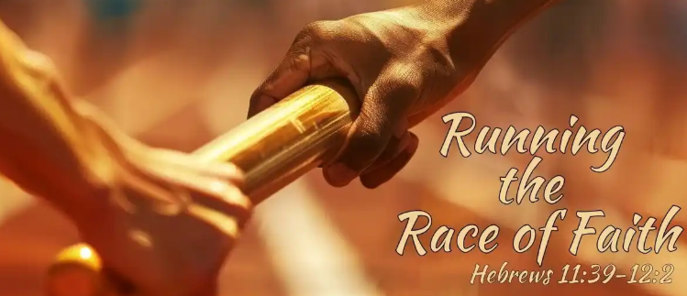

Slide 2
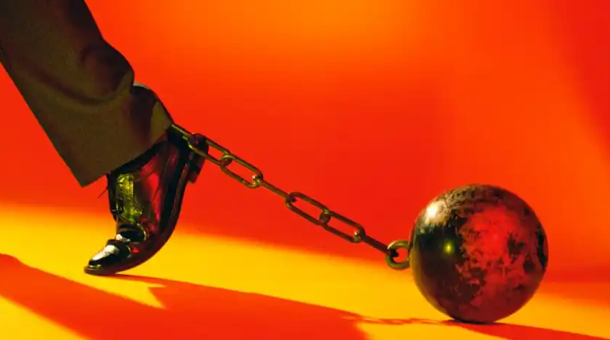
PREPARING FOR THE RACE
Luke 21:34-35
James 1:21
Ephesians 6:12
Psalm 1:1-2
2 Timothy 2:15

Slide 3

RUNNING THE RACE
Matthew 10:22
Romans 15:4
Romans 2:7
Colossians 3:1-2
John 14:1-4

Slide 4
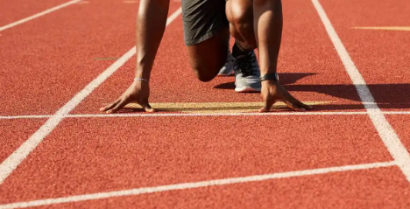
THE RACE SET BEFORE US
Hebrews 11:24-29 (moses)
Hebrews 11:8-10 (Abraham)
Hebrews 11:31 (rahab)
Acts 9:15-16 / 2 Tim. 4:7 (paul)
Hebrews 10:36

Slide 5
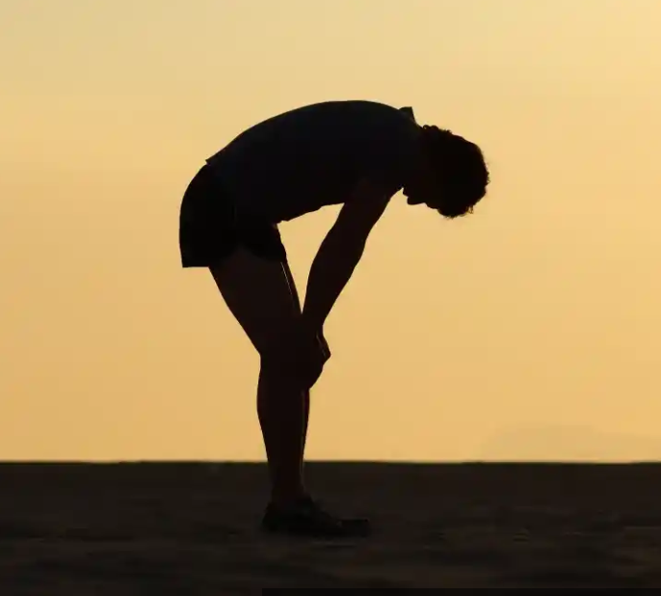
RESTING AFTER THE RACE
HEBREWS 3:7-11
MATTHEW 11:28 (REST GIVEN)
MATTHEW 11:29 (REST FOUND)
HEBREWS 4:9-10 (REST REMAINING)

Slide 6
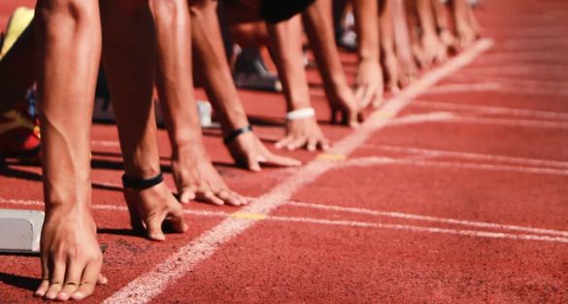
I CORINTHIANS 9:24-27
²⁴ Know ye not that they which run in a race run all, but one receiveth the prize? So run, that ye may obtain.
²⁵ And every man that striveth for the mastery is temperate in all things. Now they do it to obtain a corruptible crown; but we an incorruptible.
²⁶ I therefore so run, not as uncertainly; so fight I, not as one that beateth the air:
²⁷ But I keep under my body, and bring it into subjection: lest that by any means, when I have preached to others, I myself should be a castaway.

Slide 7
Hear the word (Rom. 10:17)
Believe in Christ (John 8:24)
Confess His name (Matt. 10:32-33; Rom. 10:9-10)
Repent of sins (Luke 13:3)
Be baptized into Christ (Mark 16:16; Rom. 6:3-5; Col. 2:12; Galatians 3:26-27)
Live faithfully until death (1 Cor. 15:58; Rev. 2:10)

